Slide 1
Help Session
Programming Assignment 1:
Timetables-R-US
Notes:
<number>

Slide 2
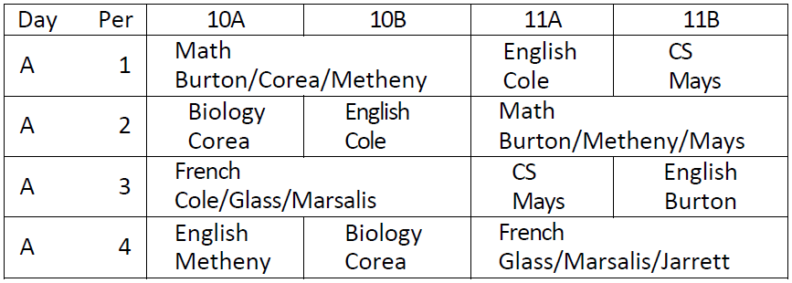
Background
Table 1: A Simple Timetable
Notes:
<number>

Slide 3
Background
Courses | = | (cno, subj, nper) | Taught by | = | (cno, tname)
Teachers | = | (tname, tload) | Taught to | = | (cno, grade, hr)
Grades | = | (grade, hr) | Assigned | = | (cno, day, per)
Periods | = | (day, per) | Assigned Backup | = | (cno, day, per)
Table 2: Database Structure
Notes:
<number>

Slide 4
Preparation
Set up your CS account
Connect to a public workstation
Set up your database
Connect to your database

Slide 5
Set Up Your CS Account
Not your Brandeis UNet ID (used to access Brandeis Account)
Read FAQs first
If you don’t have a CS account, you should:
visit guru office (Volen 125) ASAP
Send Eden your account id after that
If you forgot your CS account password, or it has expired, you should contact guru office for further assistance. Don’t need to send your account id
Otherwise, you are good to get started
Notes:
<number>

Slide 6


Connect To A Public Workstation
publicly available for students with CS accounts
public workstations list
Use the iMacs in the Vertica Lounge:
Login with your CS account
Open Terminal
Use your own machine:
SSH to a public workstation
Linux/Mac OS: Terminal
SSH usename@host
Windows: PuTTY, WinSCP
Login with your CS account
SSH
Notes:
<number>

Slide 7
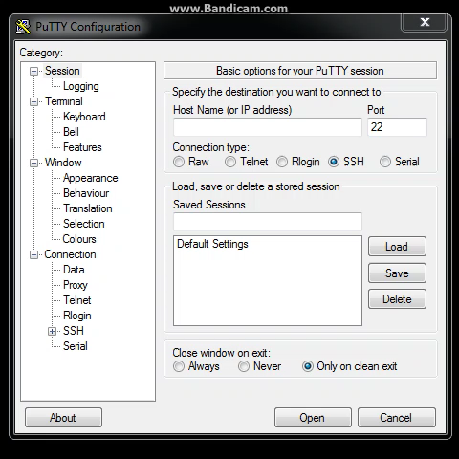
SSH Using PuTTY
Notes:
<number>

Slide 8
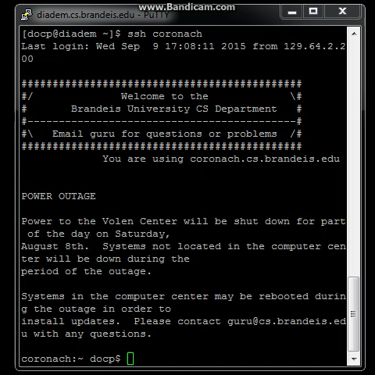
SSH Using Terminal
Notes:
<number>

Slide 9
Set Up Your Database
Copy the provided compressed file
$ cp /home/o/class/cs127b/PA1/PA1Files.tar.gz .
Uncompress it to get a folder “MyPA1”
$ tar -xzvf PA1Files.tar.gz
Change directory to “MyPA1”
$ cd MyPA1
Run the provided script to initialize or reset your database, it will create tables, and insert values into those tables
$ psql -h host < pa1-initdb.sql
host: replace it with your assigned database server address
password: your CS account id is the default password
Notes:
<number>

Slide 10
Assigned Database Server
Group |  | Assigned Database Server
1 | : | vpgs01.cs.brandeis.edu
2 | : | vpgs02.cs.brandeis.edu
3 | : | vpgs03.cs.brandeis.edu
4 | : | vpgs04.cs.brandeis.edu
5 | : | heracles.cs.brandeis.edu
6 | : | laomedon.cs.brandeis.edu
7 | : | aviator.cs.brandeis.edu
Notes:
<number>

Slide 11
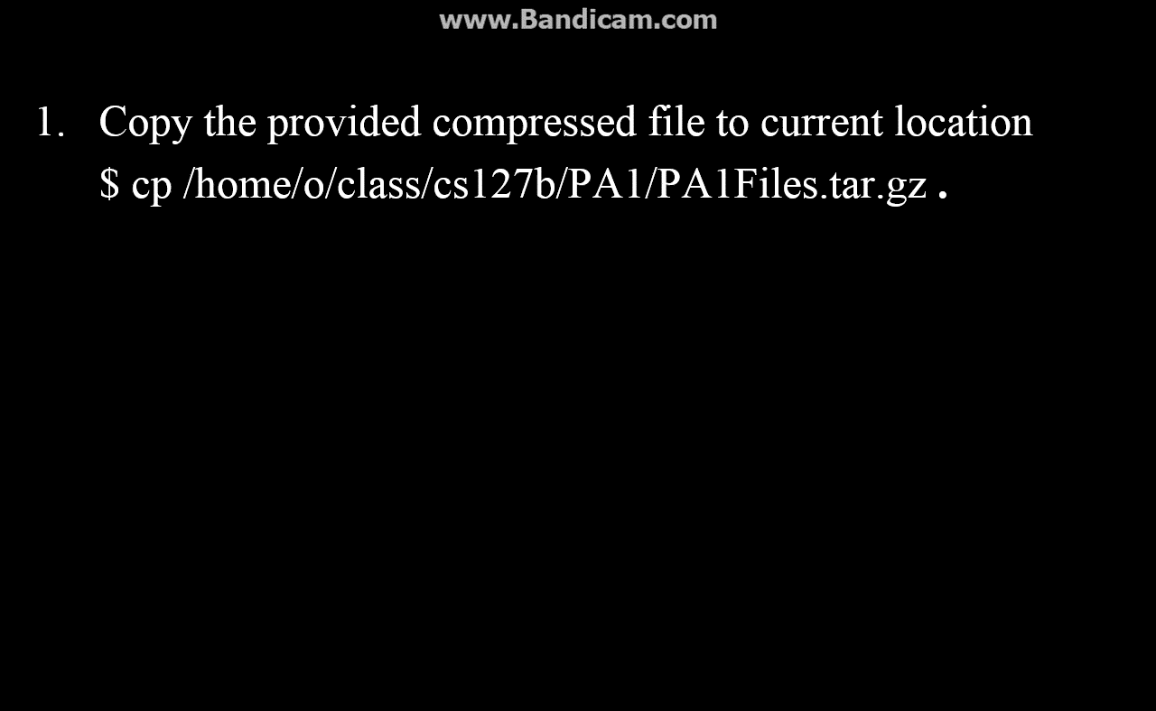
Set Up Your Database
Notes:
<number>

Slide 12
Connect to Your Database
Connecting to your database
$ psql -h host
Modify your password using the following query:
ALTER USER username WITH PASSWORD ‘newpassword’;
username is your CS account id
newpassword is the new password to set
Notes:
<number>

Slide 13
PSQL
enables you to type in queries, issue them to PostgreSQL, and see the results
some useful psql commands:
\h lists all the commands with available syntax help
\h cmd gives syntax help on the specified SQL command
\d shows a list of all visible tables
\d table shows schema of the specified table
\q exits psql
Check PostgreSQL documentation for more details
Notes:
<number>

Slide 14
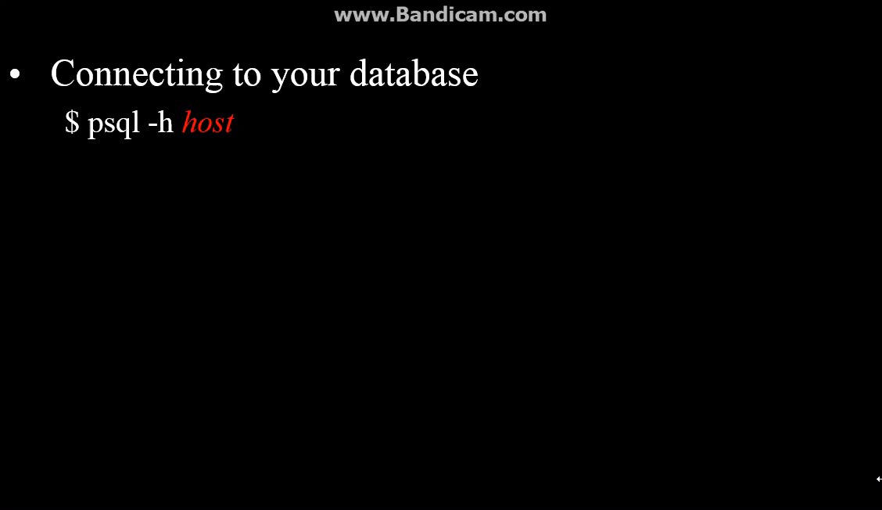
Demo
Notes:
<number>

Slide 15
Things You Need to Know
Temporary tables can only be used for Q14-19. You should clean your temporary tables after use.
Before asking questions, you should check the Latte forums, and post your questions there. TAs would not answer questions in email.
If you have technique issues (e.g., cannot connect to your database), you should send me an email directly.
This assignment requires both hard and electric copy. You should bring your hard copy to class and submit your electric copy on Latte before 3:30 p.m., Monday, September 21. Late submissions should be sent to me via email.
The electric copy should ONLY contain SQL. Copy and paste your queries from psql. Write your comments in hard copy.
No collaboration is permitted on programming assignments!
Notes:
<number>

Slide 16
Good Luck!
Notes:
<number>

Slide 17
Group 1
Last | First
Sarah | Adler
Maria | Altebarmakian
Boyang | An
David | Barsky
Chelsea | Baush
Eric | Benzschawel
Arya | Boudaie
Jackson | Breyer
Will | Burstein
Erica | Chai
Jiaqian | Chen
Shu | Chen
Tianzhi | Chen
Tiffany | Chen
Allan | Chesarone
Notes:
<number>

Slide 18
Group 2
Last | First
Steven | Colon
Edward | Colvin
Oscar | Courchaine
Todd | Curcuru
Katherine | Currier
Mojir | Darzi
Han | Du
Efe | Esenwa
Aidan | Gainor
Huilin | Gang
Swini | Garimella
Jiapeng | Geng
David | Giliotti
Aviv | Glick
Liangwei | Guo
Notes:
<number>

Slide 19
Group 3
Last | First
Zhenyu | Han
Tim | Hu
Zhengyu | Huang
Ari | Kalfus
Paul | Kang
Geula | Katan
Andrew | Kouides
Viet | Le
Jaemo | Lee
Shuyi | Lei
Eric | Leviton
Jiaqi | Li
Jishan | Li
Benjamin | Lim
Damian | Lin
Notes:
<number>

Slide 20
Group 4
Last | First
Chao | Liu
James | Liu
Vicky | Liu
Yalin | Liu
Yang | Liu
Xingyu | Lu
Yuanyuan | Ma
Artem | Malyshev
Shimon | Mazor
Kelvin | Mei
Can | Nahum
Giang | Nguyen
Andrew | Parker
Kemi | Peng
Wei | Qian
Notes:
<number>

Slide 21
Group 5
Last | First
Xi | Qian
Cong | Qiao
Kechen | Qin
Seth | Rait
Tifara | Ramelson
Siting | Ren
Keigh | Rim
Michael | Roytman
Jonathan | Schmeling
Burak | Sezer
Notes:
<number>

Slide 22
Group 6
Last | First
Brandon | Shapiro
Shuangchen | Shen
Mo | Shi
Eden | Shoshan
Martin | Silberberg
Meital | Singer
Meiyue | Song
Ruihua | Song
Elena | Stoeri-D'Arrigo
Hui | Sun
Notes:
<number>

Slide 23
Group 7
Last | First
Vladimir | Susaya
Chungyuk | Takahashi
Bryan | Turcotte
Ben | Vizlakh
David | Wan
Calvin | Wang
Jerry | Wang
Xinyue | Wang
Zheng | Wang
Patricia | Whitlock
Shuao | Xiong
Xin | Yao
Anna | Yatskar
Michael | Yu
Cuimei | Zhang
Yiran | Zheng
Leifeng | Zhou
Wan | Zhou
Mengdi | Zhu
Jing | Zou
Notes:
<number>

